Slide 1


Slide 2
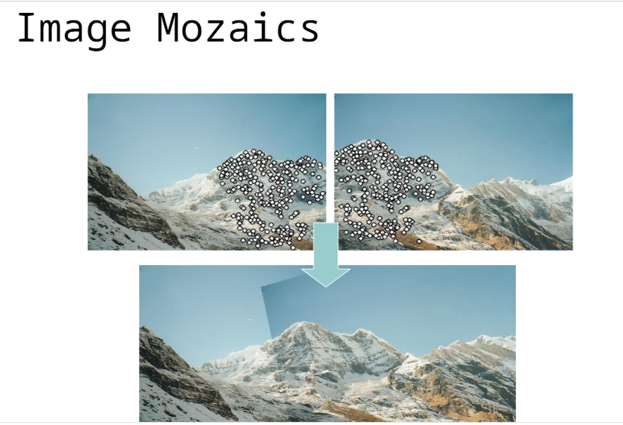
Image mosaicing is an effective means of constructing a single seamless image by aligning multiple partially overlapped images.
Image alignment is the process of overlaying images of the same scene under different conditions, such as from different viewpoints, with different illumination, using different sensors, or at different times.

Slide 3
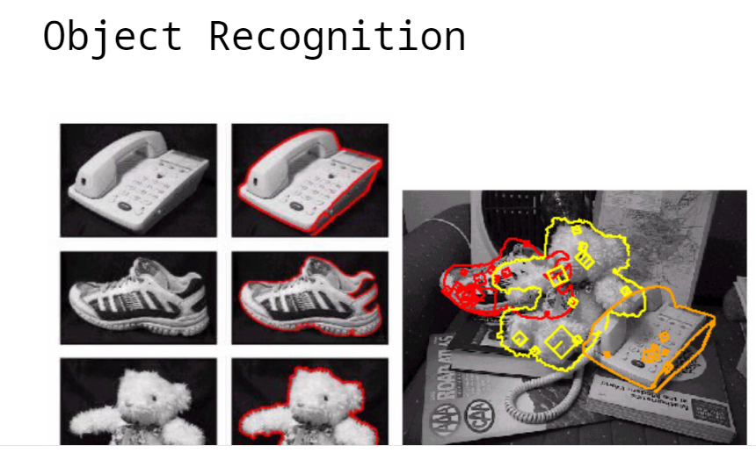

Slide 4
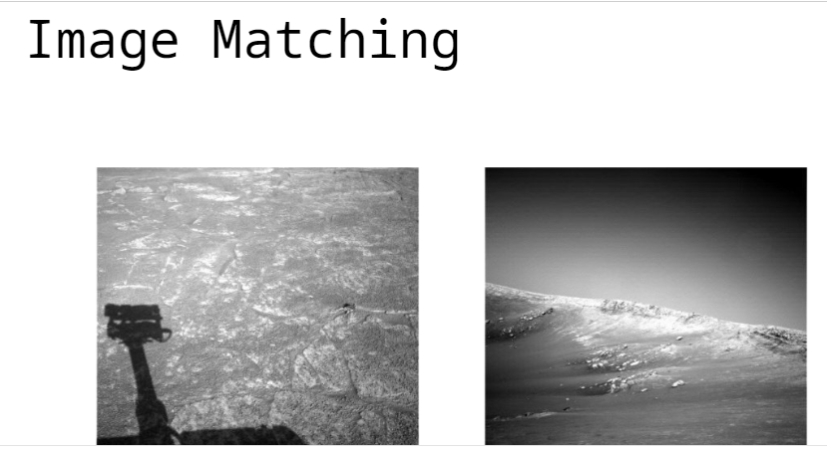

Slide 5
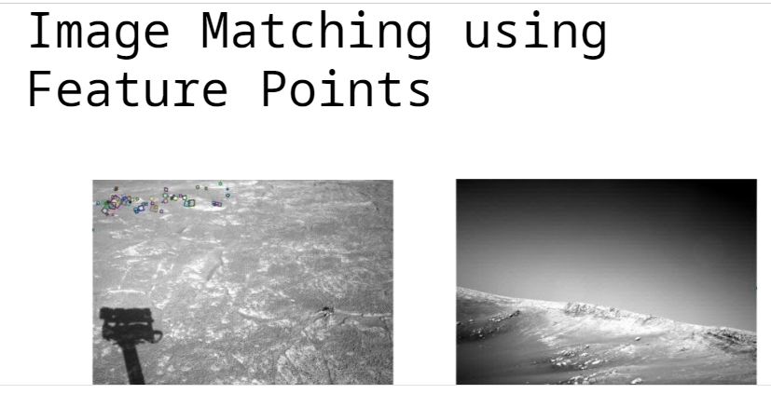

Slide 6
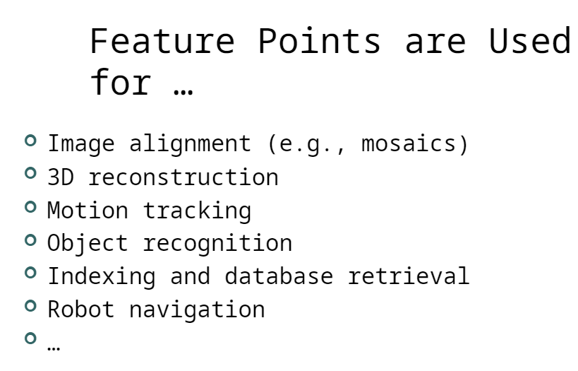

Slide 7
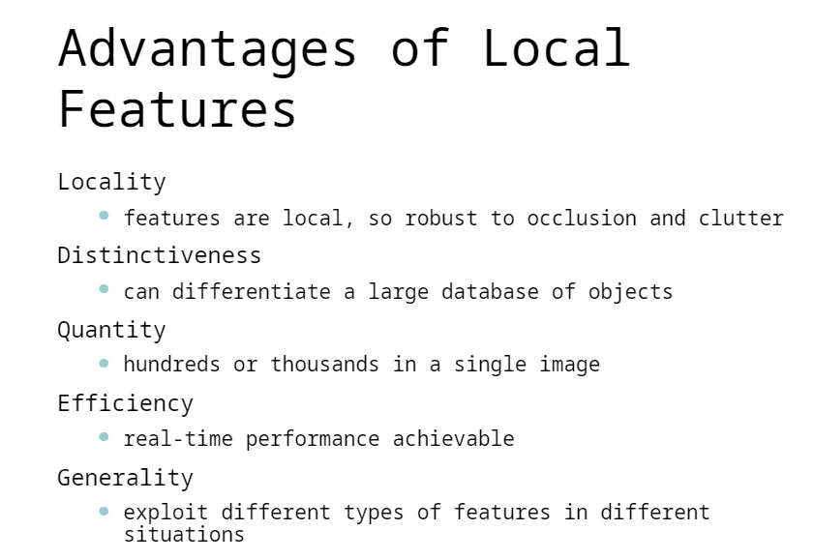

Slide 8
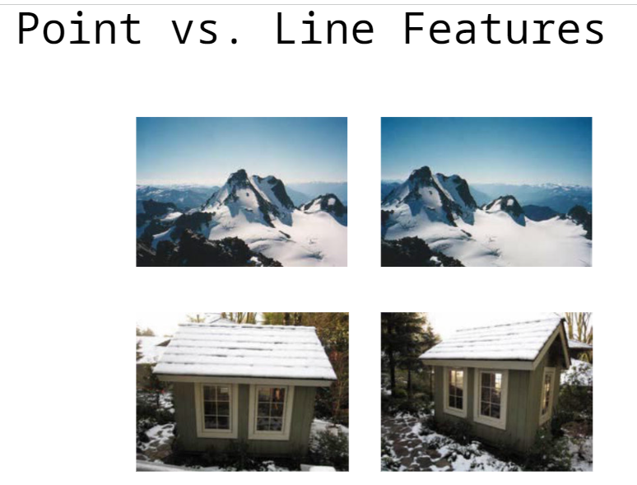
The point features that will be used to construct lines.
The line feature class that will be created from the input points. The field that will be used to identify unique attribute values so line features can be constructed using points of the same values.

Slide 9
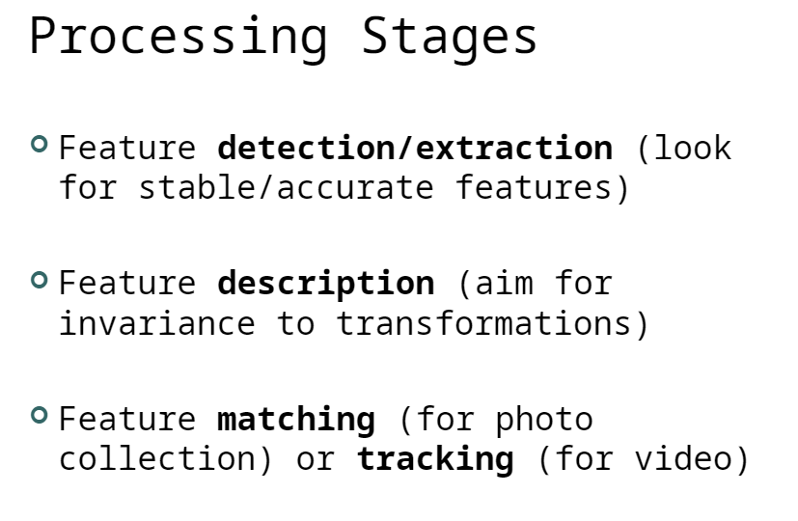

Slide 10
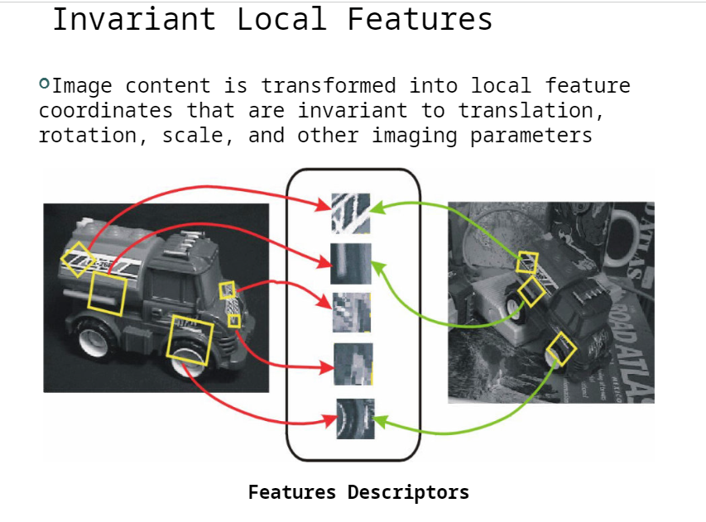
Invariant features are image characteristics which remain unchanged under the action of a transformation group

Slide 11


Slide 12
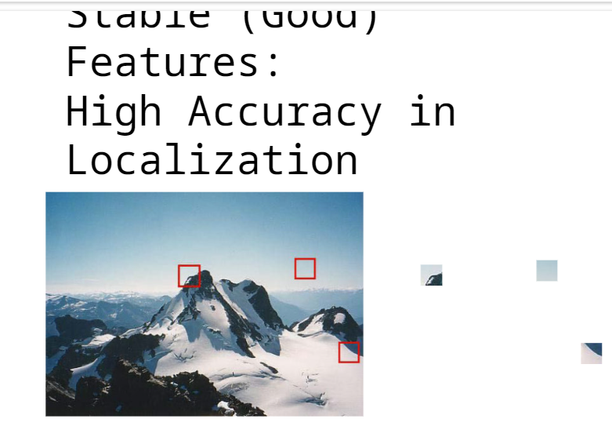

Slide 13
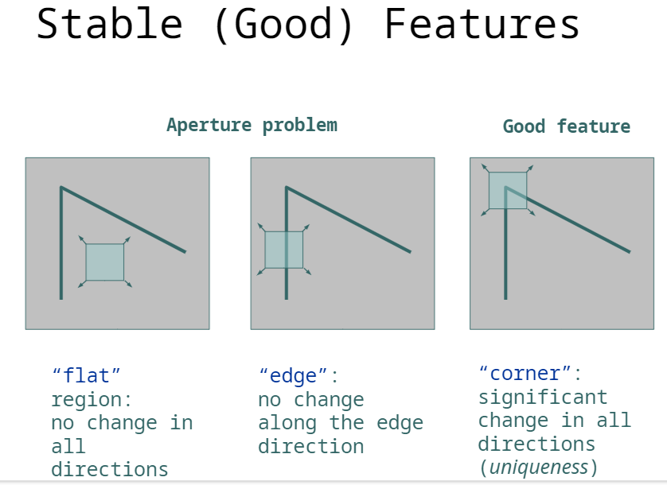

Slide 14
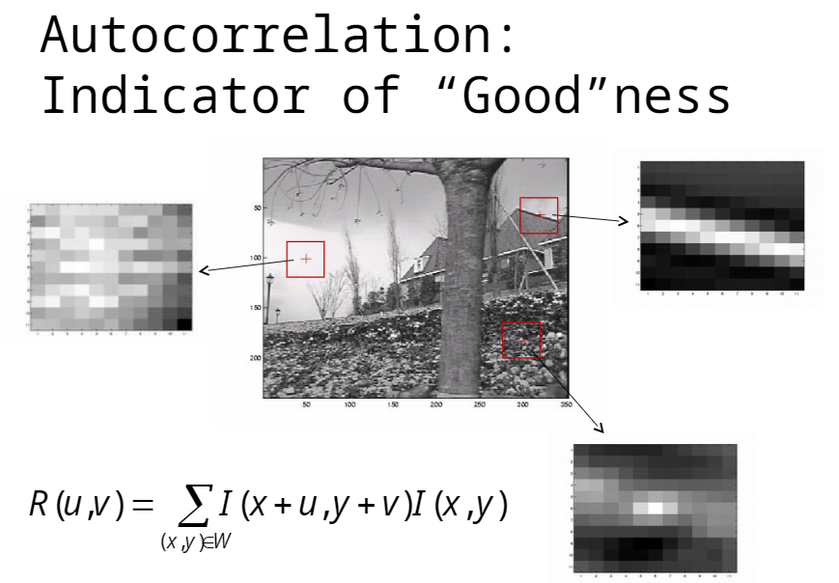

Slide 15
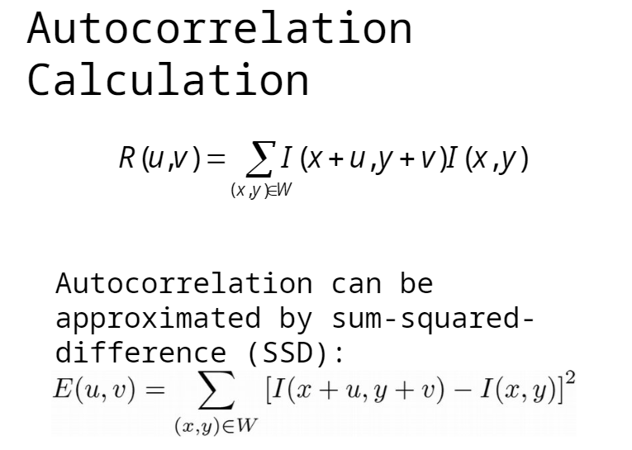

Slide 16
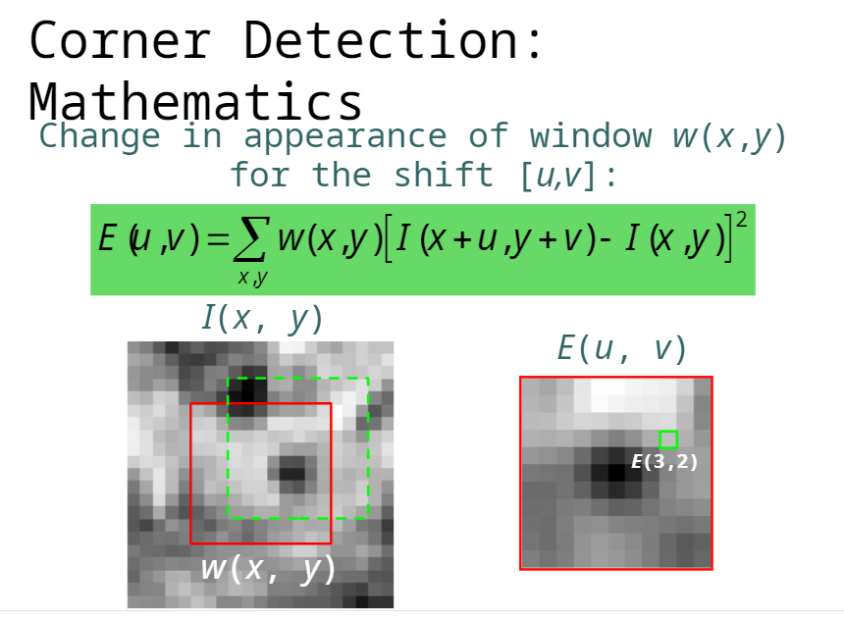

Slide 17
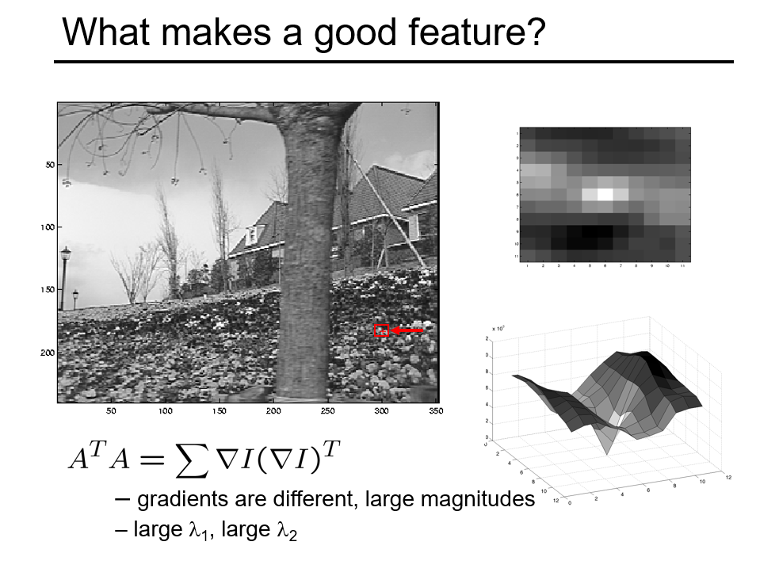

Slide 18
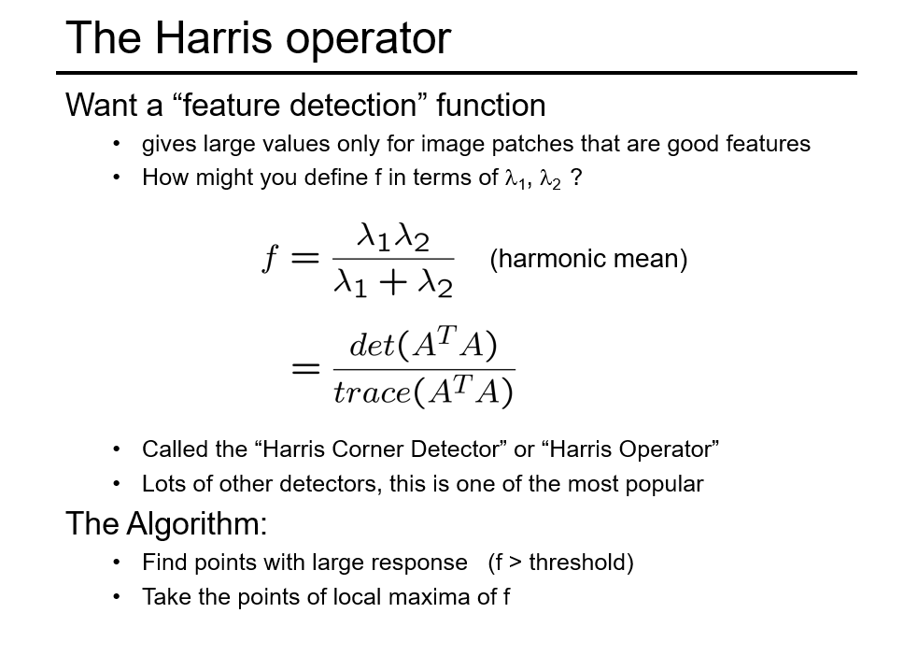

Slide 19
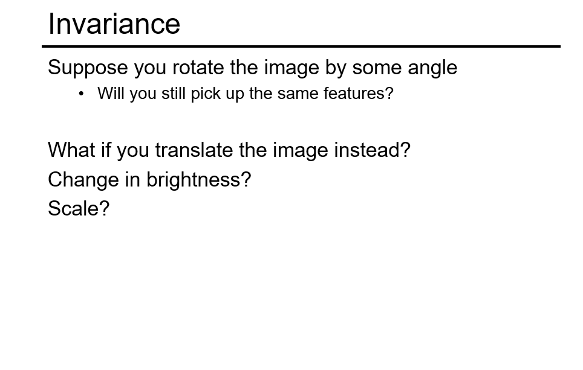

Slide 20
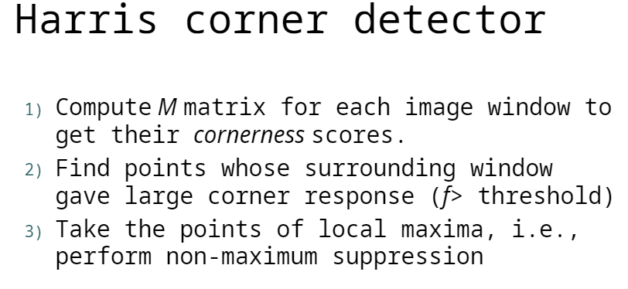

Slide 21
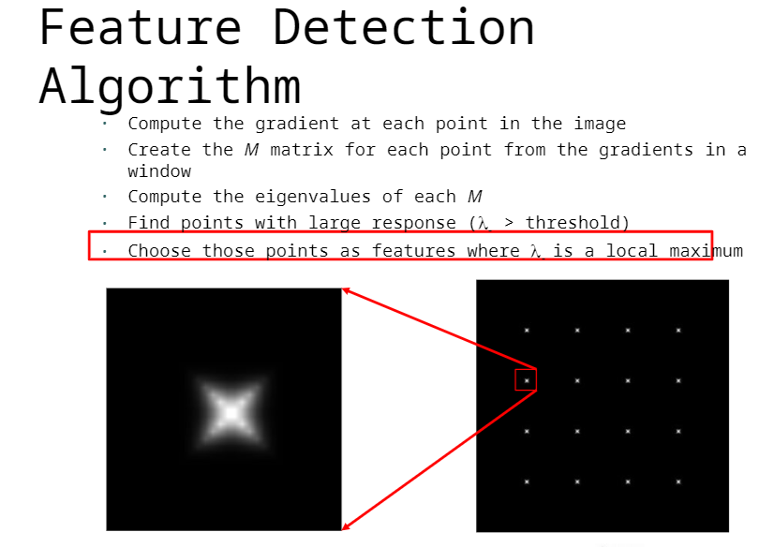

Slide 22
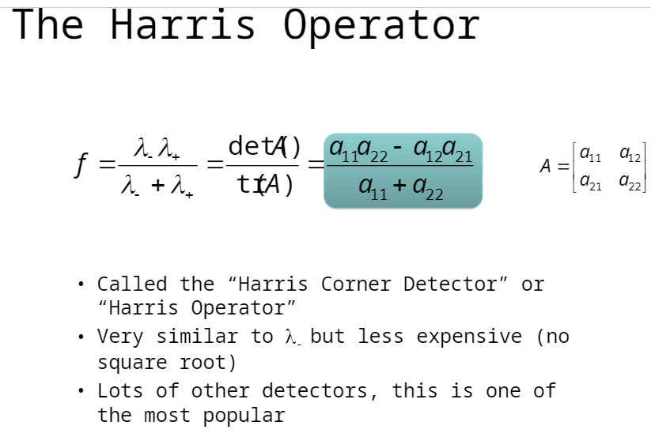

Slide 23
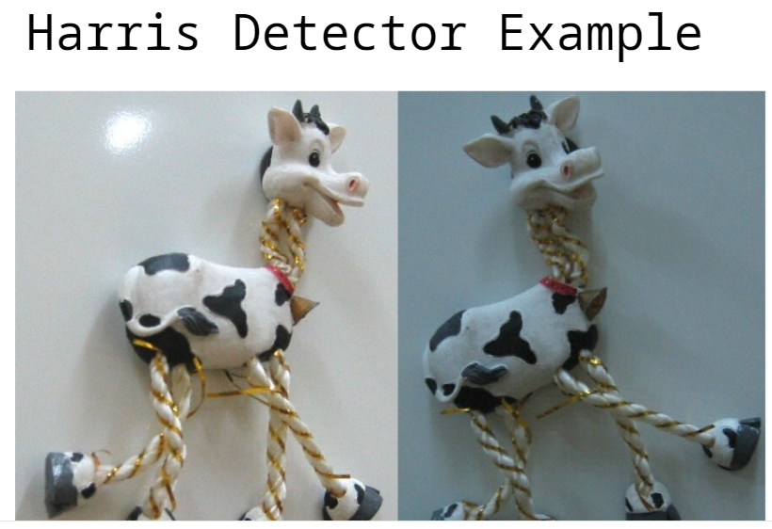

Slide 24
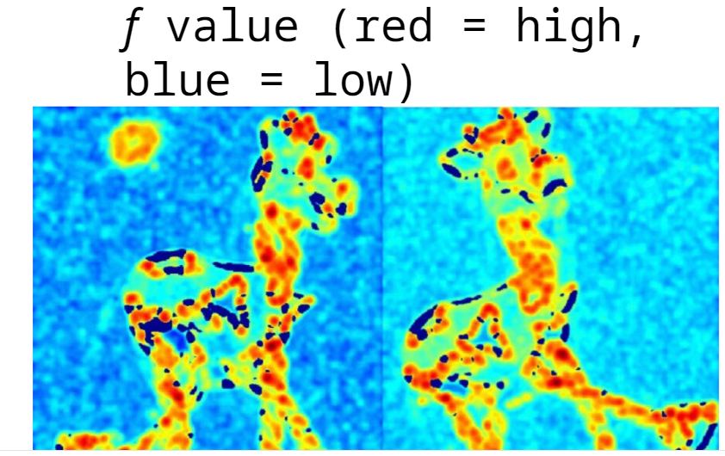

Slide 25
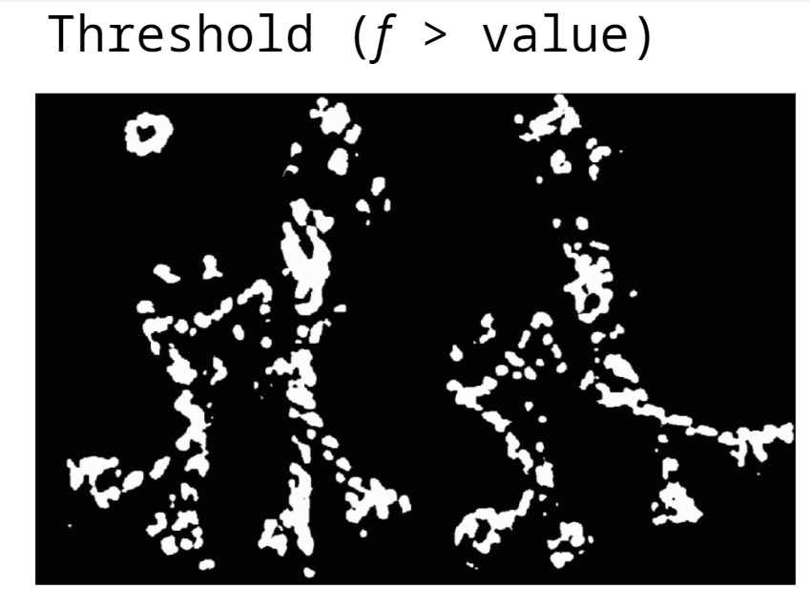

Slide 26
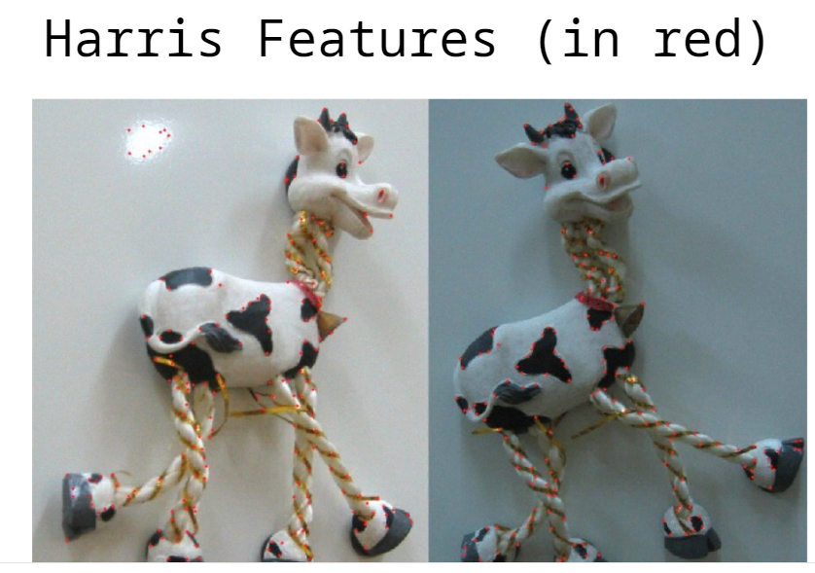

Slide 27


Slide 28
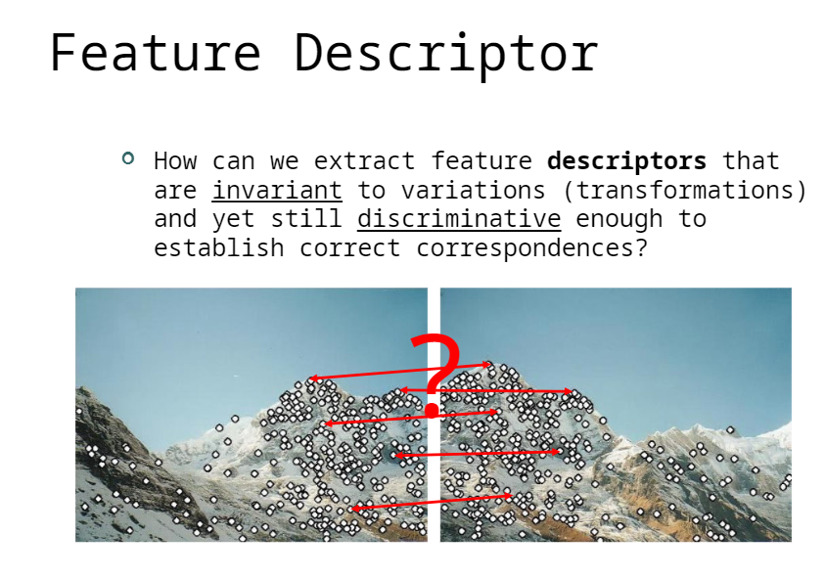

Slide 29
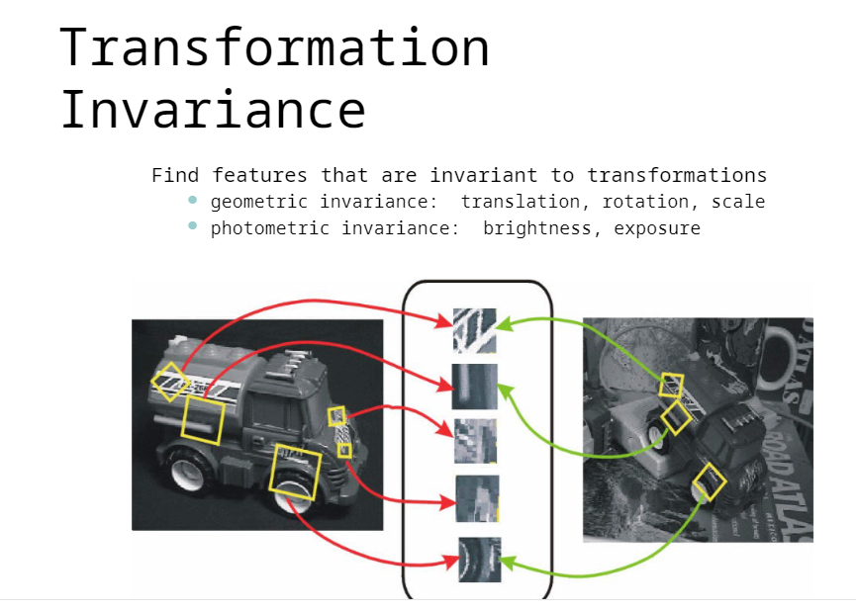

Slide 30
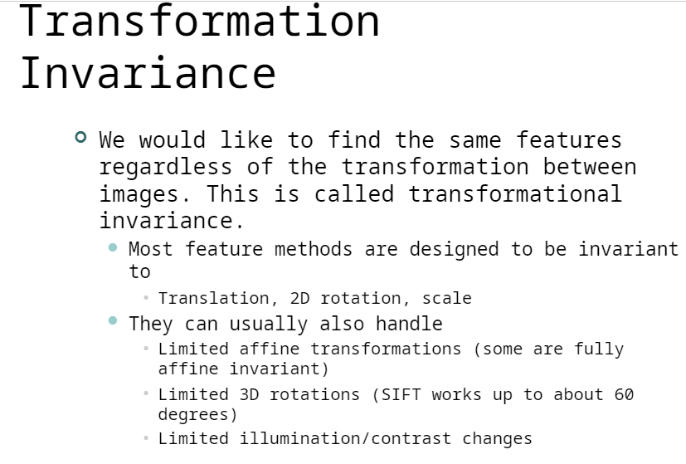

Slide 31
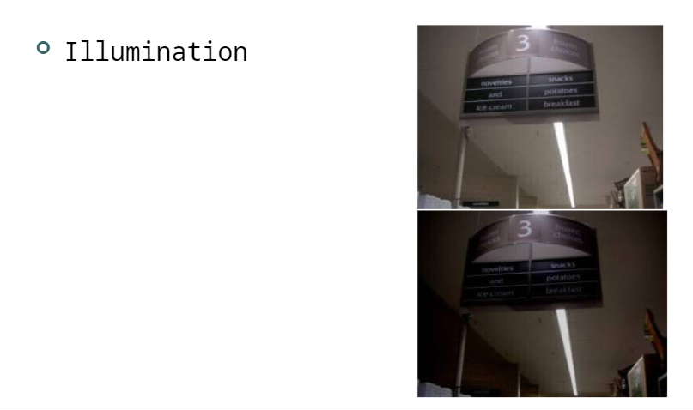
Types of invariance

Slide 32
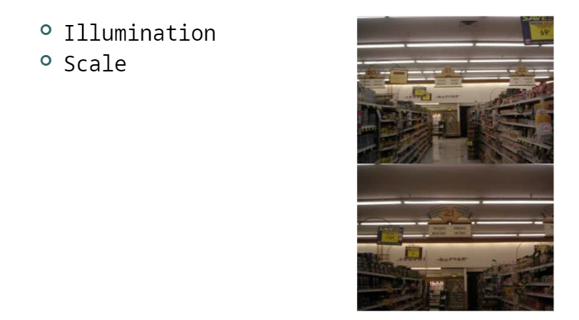

Slide 33
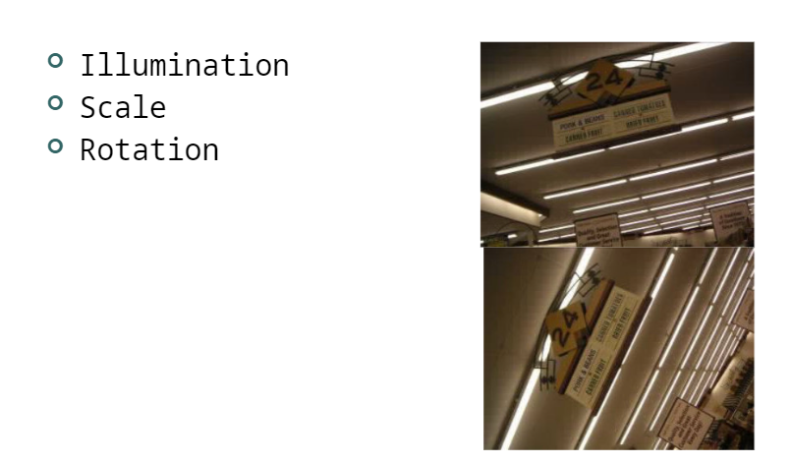

Slide 34
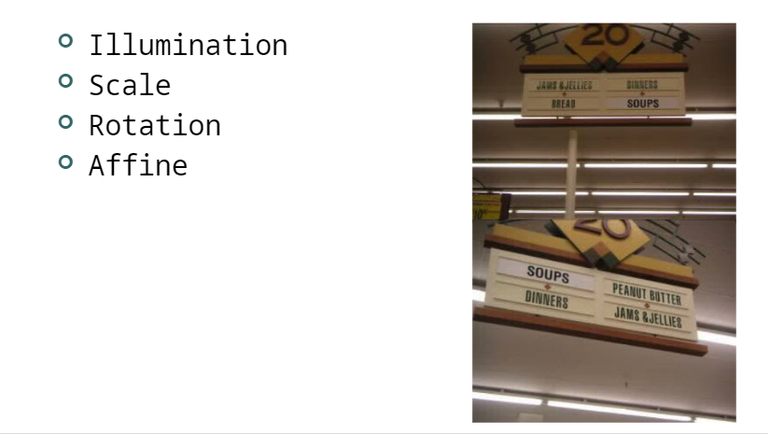

Slide 35
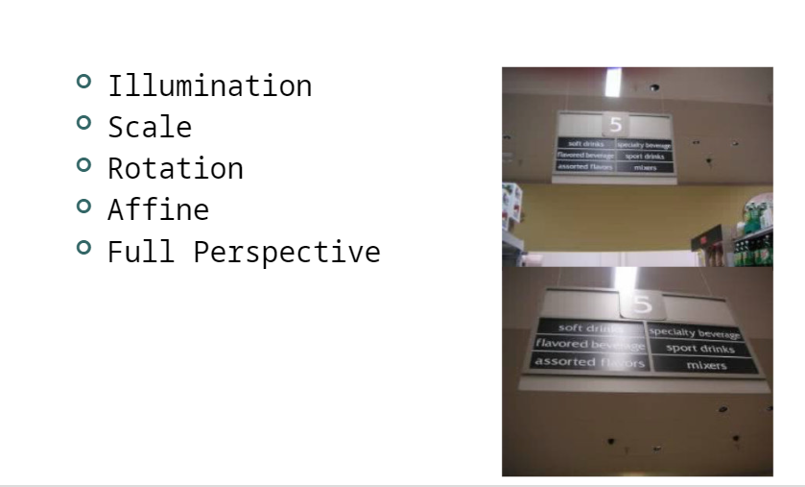

Slide 36
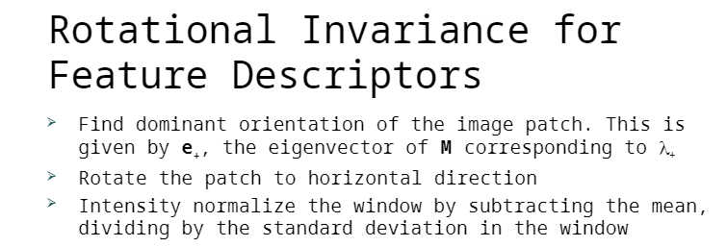
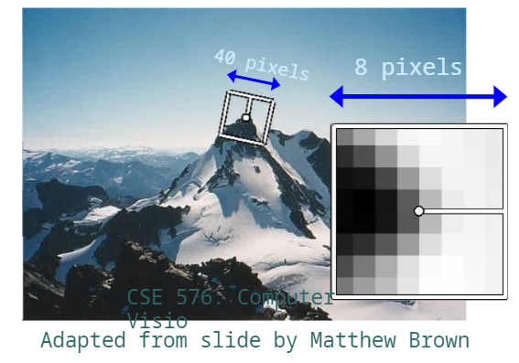

Slide 37
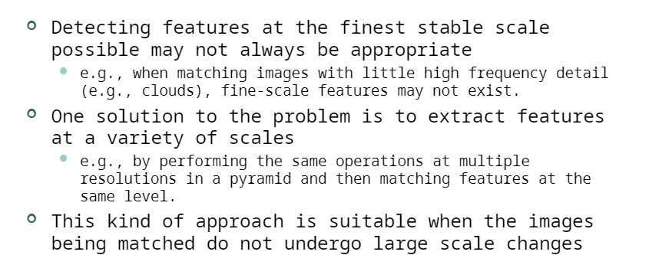
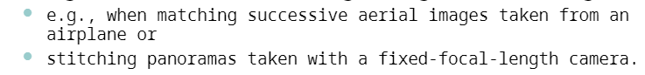
Scale Invariance

Slide 38
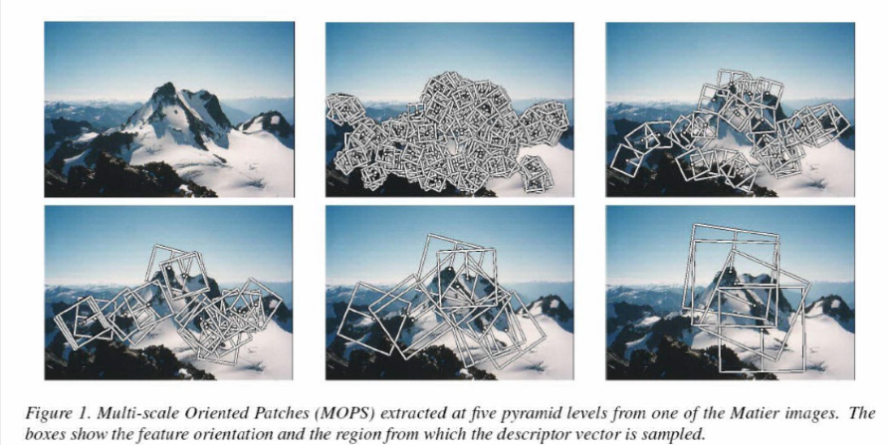
Scale Invariance for Feature Descriptors

Slide 39
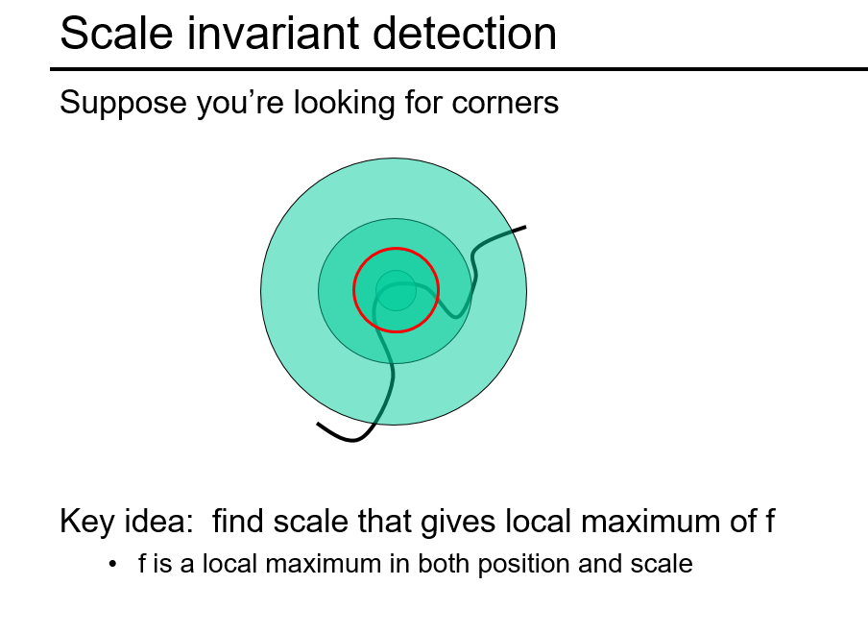

Slide 40
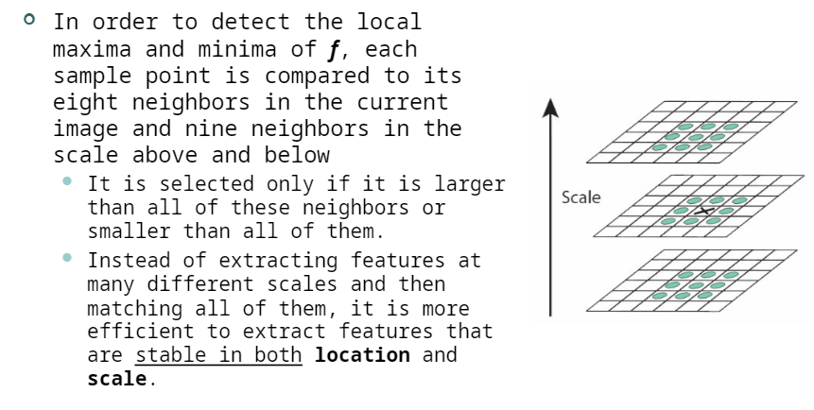
Scale Invariant Feature Transform (SIFT) Features

Slide 41
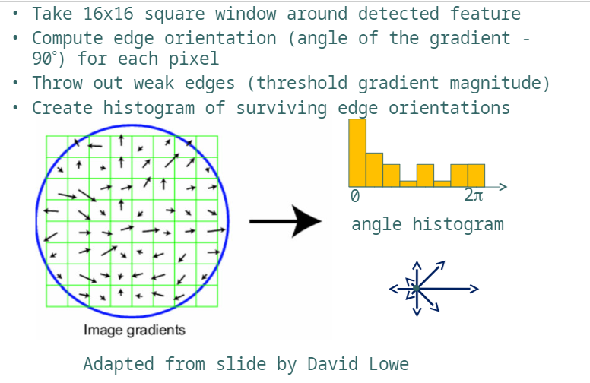
Scale Invariant Feature Transform

Slide 42
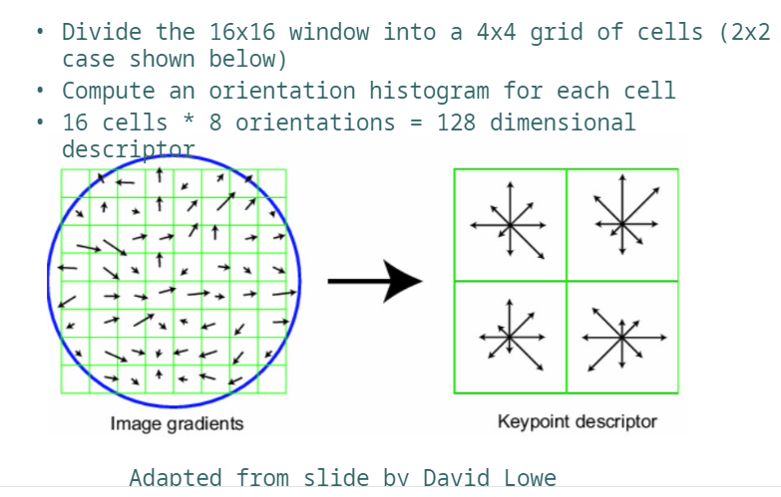
SIFT Descriptor

Slide 43
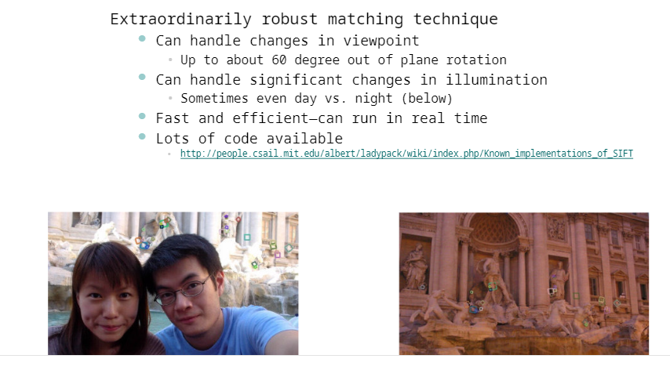
Properties of SIFT

Slide 44
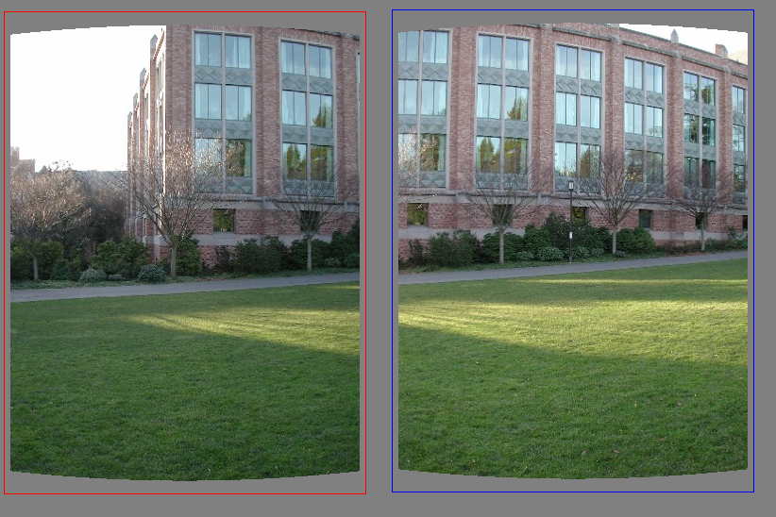
Matching features
What do we do about the “bad” matches?

Slide 45
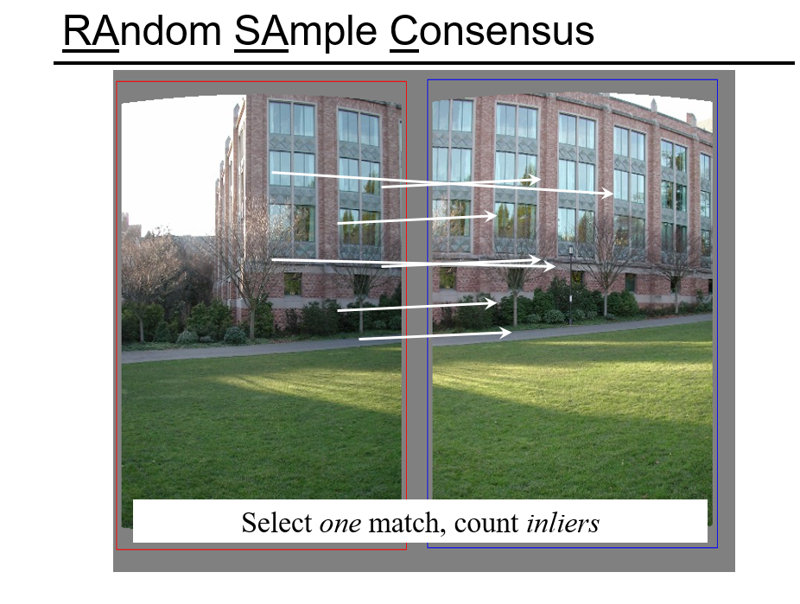

Slide 46
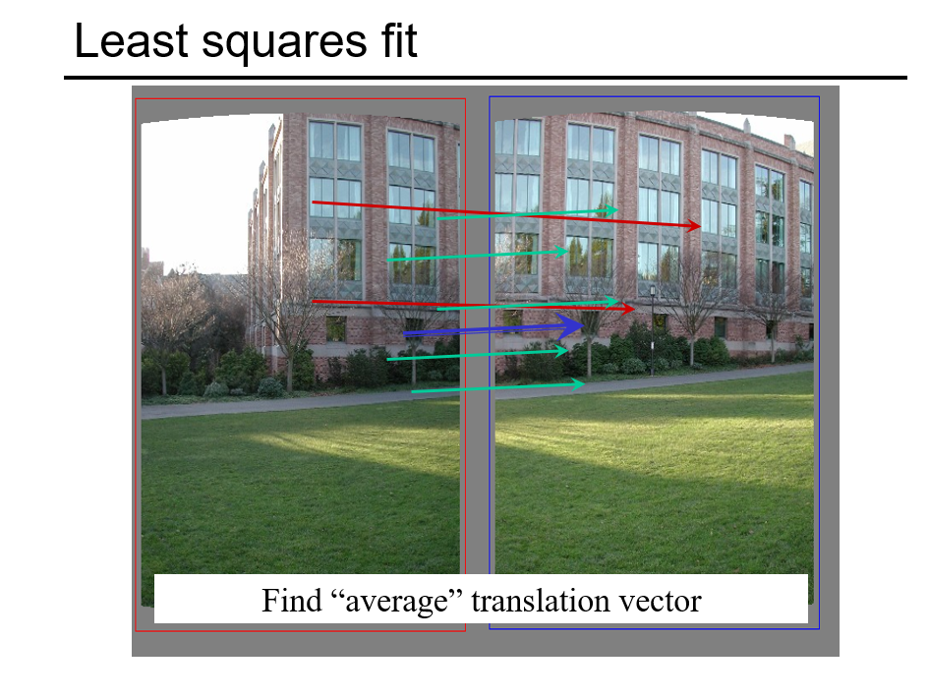

Slide 47
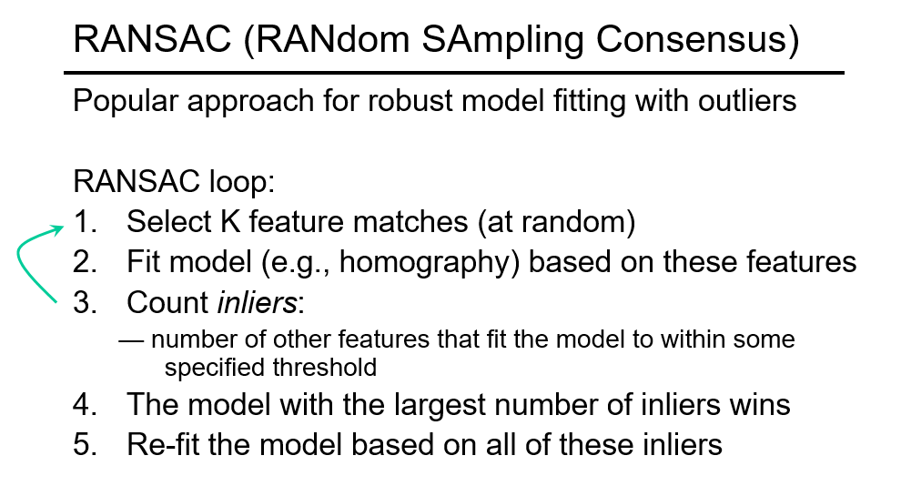

Slide 48
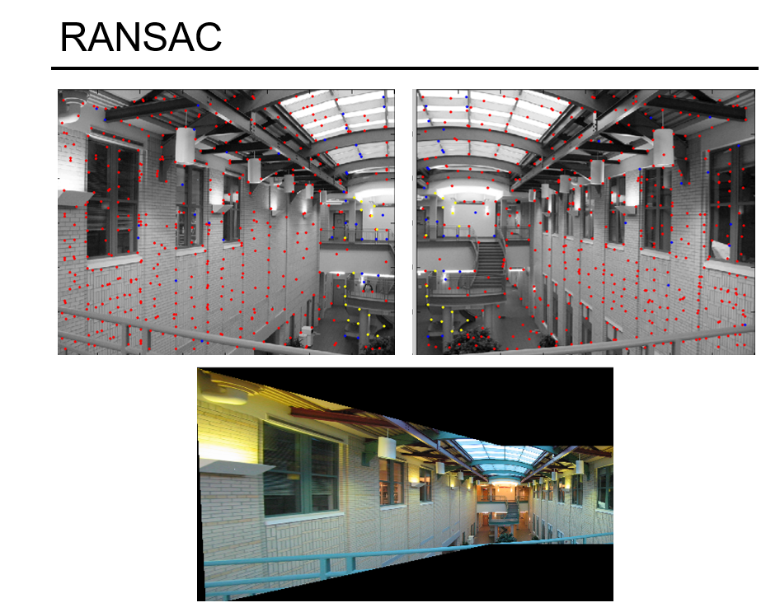

Slide 49
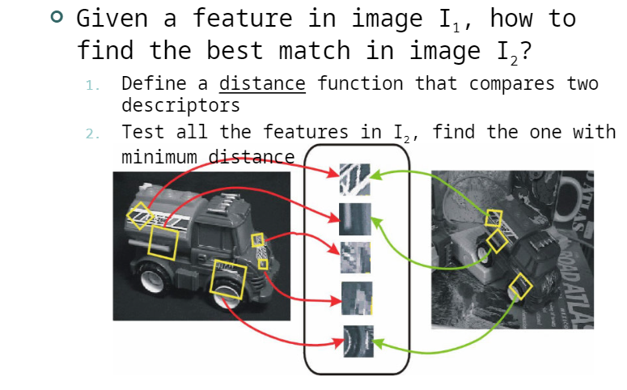
Feature Matching

Slide 50
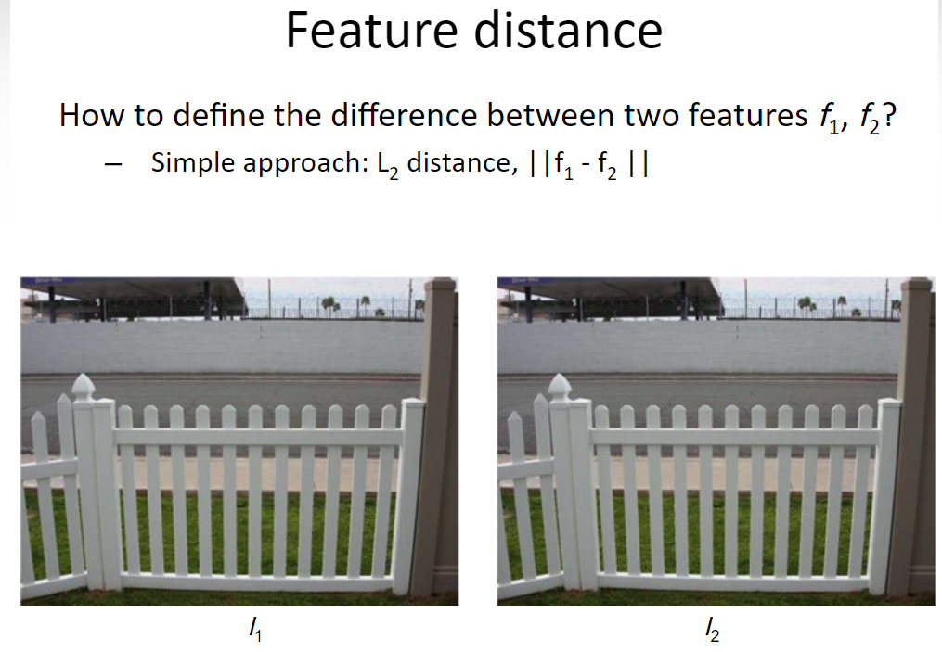

Slide 51
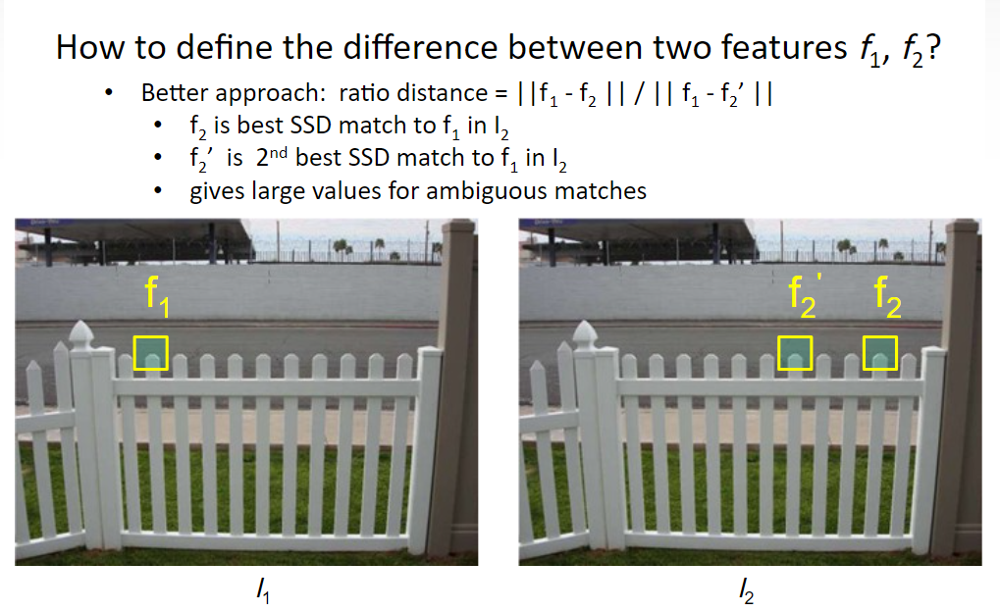

Slide 52


Slide 53


Slide 54


Slide 55

Terminology

Slide 56

Recall, Precision, and F-Number

Slide 57

True and False Positive Rates

Slide 58

Evaluating the Performance of a Feature Matcher

Slide 59


Slide 60


Slide 61


Slide 62


Slide 63


Slide 64


Slide 65


Slide 66


Slide 67


Slide 68


Slide 69


Slide 70


Slide 71


Slide 72


Slide 73


Slide 74


Slide 75


Slide 76



Slide 77


Slide 78


Slide 79



Slide 80




Slide 81


Slide 82


Slide 83


Slide 84


Slide 85


Slide 86


Slide 87


Slide 88


Slide 89



Slide 90


Slide 91


Slide 92


Slide 93


Slide 94


Slide 95


Slide 96


Slide 97


Slide 98


Slide 99


Slide 100


Slide 101


Slide 102


Slide 103


Slide 104


Slide 105


Slide 106


Slide 107


Slide 108


Slide 109


Slide 110


Slide 111


Slide 112


